Slide 1
The Evolution of Modern Cybersecurity
By: Kevin Hamzaj

Slide 2

Introduction
I attended a virtual cyber security seminar called “The Evolution of Modern Cybersecurity”. The speaker, Andrew Humphrey speaks on the latest threats and how modern cybersecurity solutions are evolving to stop them and, also how security is changing from a reactive to a proactive approach.

Slide 3
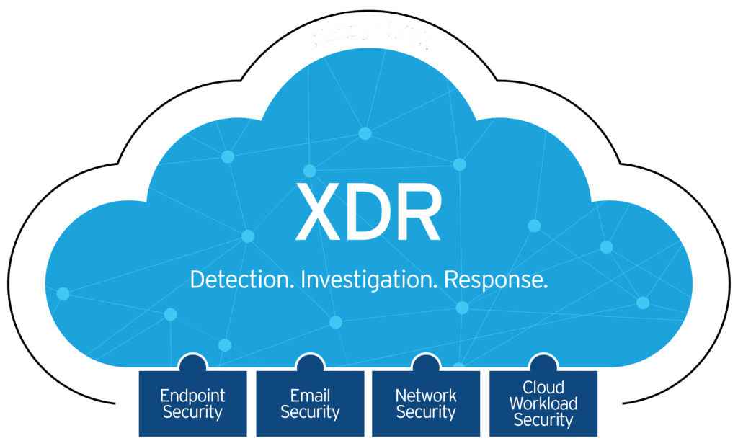
eXtended Detection and Response (XDR)
The speaker explains that the definition of XDR is simply “having all of your security products talk to each other”. XDR reports all information in a single dashboard, this decrease time to detect and decreases time to response to avoid problems. Lets say your email security picking up a phishing attack, XDR will pick up that problem and remove it from all of your infrastructure.

Slide 4
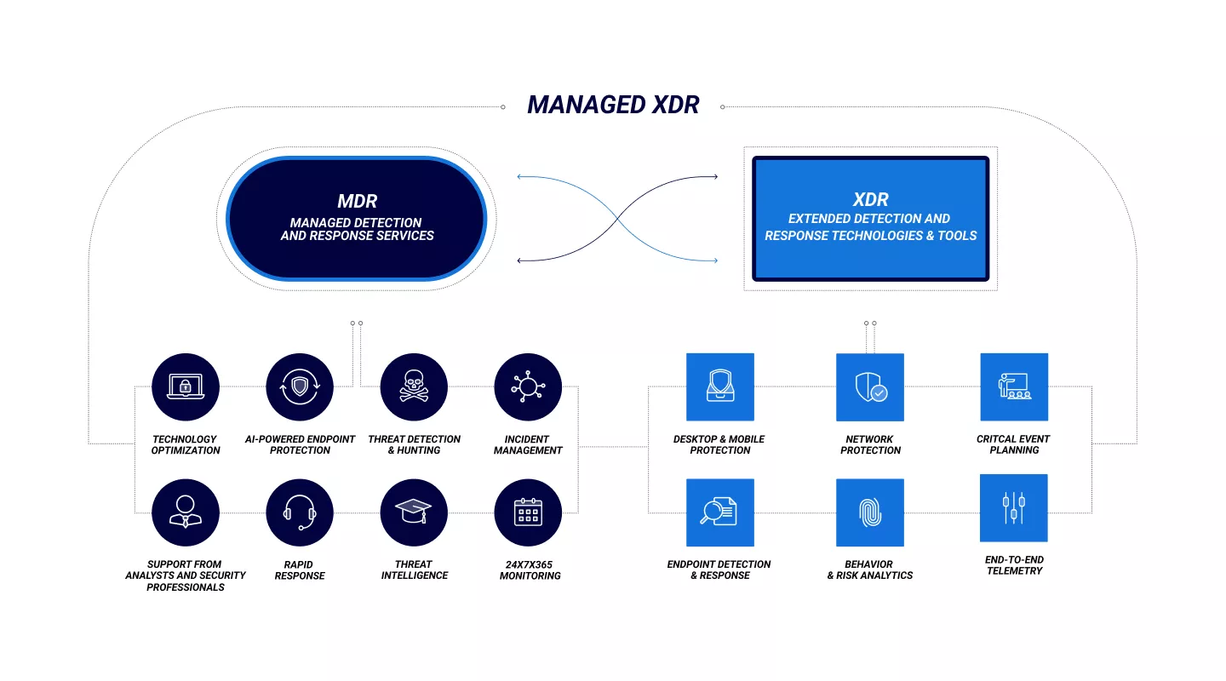
Managed XDR
Managed Extended Detection and Response (Managed XDR) is the application of a managed services framework to XDR. It augments and optimizes threat detection, investigation, response, and hunting across a business’s entire IT ecosystem.

Slide 5
What XDR comes with
Support from experienced analysts and security professionals
24x7x365 monitoring
AI-powered endpoint protection
Continuous threat detection and hunting
Incident/event management and response
Notification management
Compliance management
Preauthorized and customizable analyst interactions and interventions
Advanced orchestration
Tailored response playbooks, triage, and filtering methods
Organized, contextualized telemetry

Slide 6
XDR benefits for companies
Need for increased security
Business risk reduction
Consolidation for cost savings
Cyber insurance
Simplicity

Slide 7
Attack Surface Risk Management (ASRM)
XDR is more of a reactive thing, while ASRM is more of a proactive approach. ASRM looks at what goes on in the environment and what creates that risk. It breaks out all individuals users and assigns them a risk score based on they’re activity. ASRM will give you corrective actions, like blocking certain websites, tell you to initialize these password criterias, etc. It will do all this to improve that risk score and make your company more safe from attacks.

Slide 8
Good Cyber Hygiene
Change passwords frequently (Make sure they are complex and not the same in different locations)
Be reasonably cautious (Don’t click on links, or act on prompts from strangers)
Update systems Update, Update and UPDATE!!! (Reason companies put up updates, is because they is vulnerabilities in the software)
Know who to contact if something is wrong in your company

